Slide 1



Team 25-MSAMI
■Project
: Android App for HanYang University Student
■Team Member
Park Jae Yong
Kim Min Sang
Kim Dong Gyu

Slide 2

Contents
Member Introduce
App Introduce
Product and Result
Our Task(Develop & Problem)
Reference & License
Future plan

Slide 3



Already

Slide 4
Product and Result

Slide 5
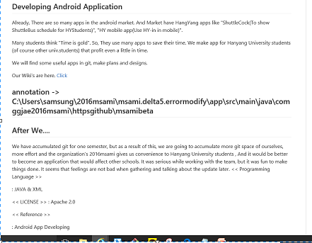
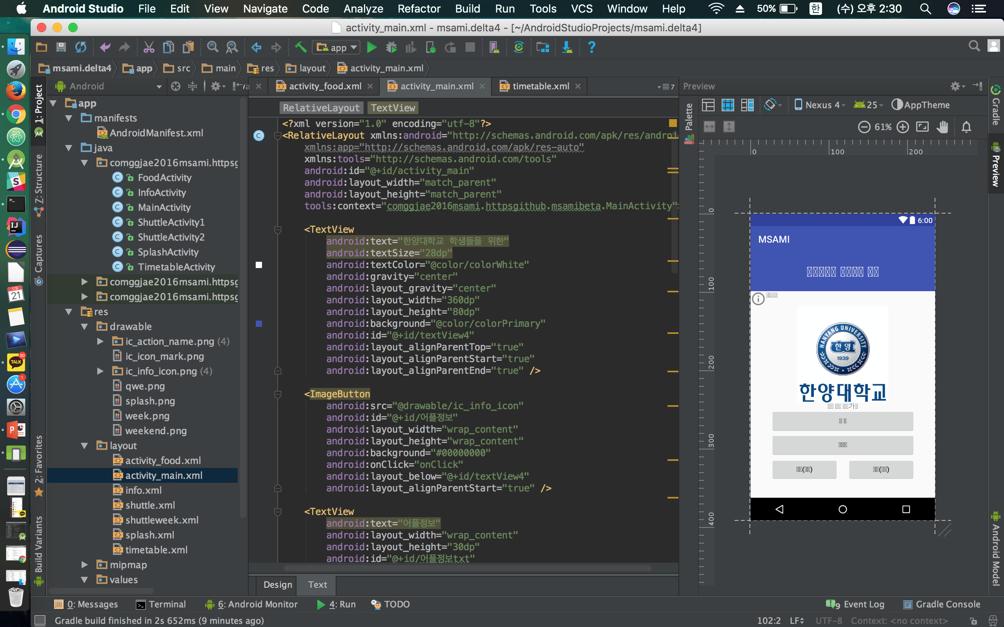
Outline & Using Language
Language :
JAVA
Program :
Android Studio

Slide 6
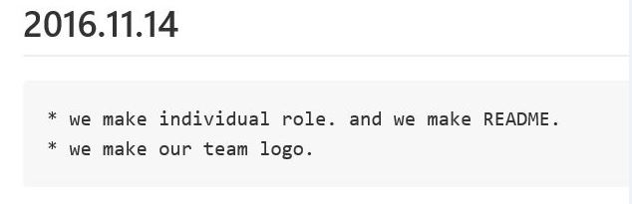
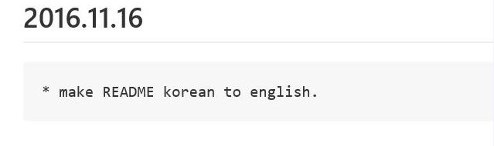
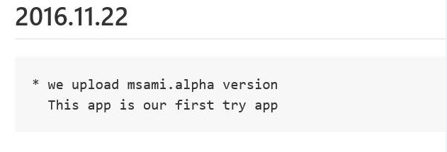
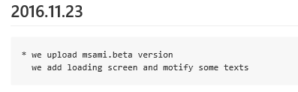
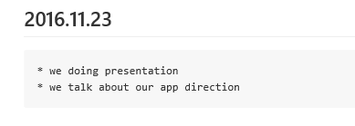
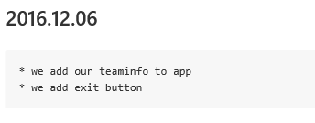
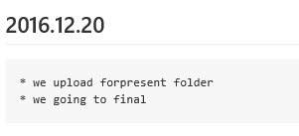
What We Have Done?
⊙Make Individual Role
⊙Make Outline
⊙Develop!
⊙Upload alpha version
⊙Make beta version
⊙Make Final version!

Slide 7
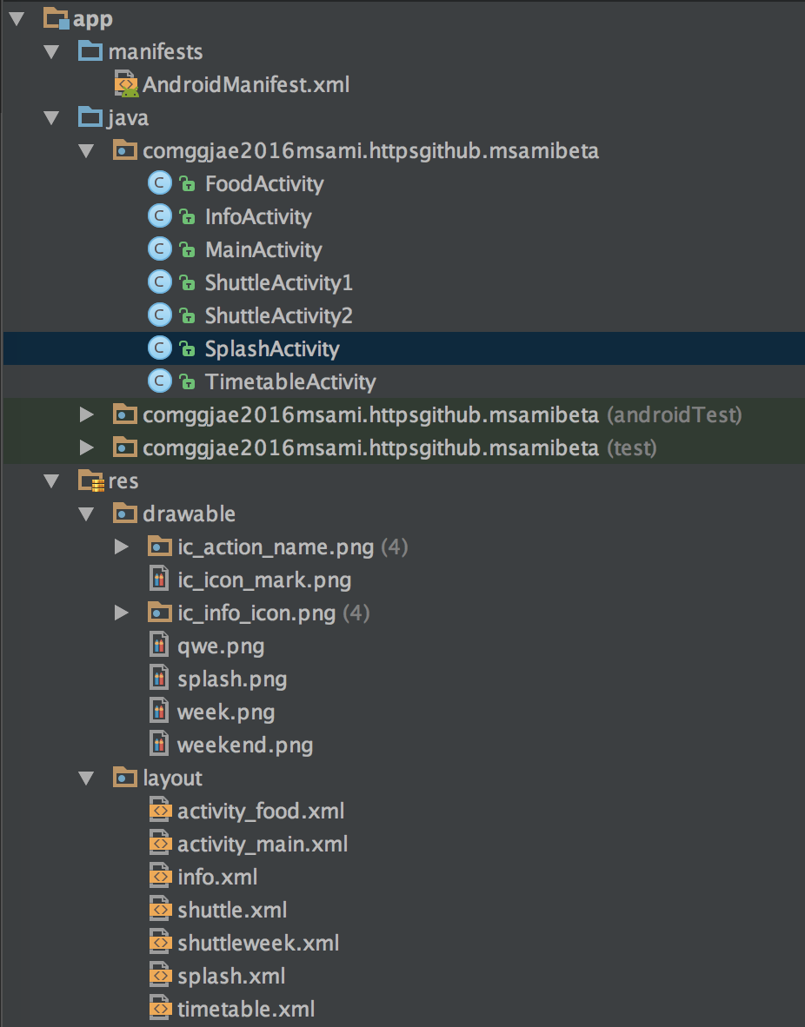
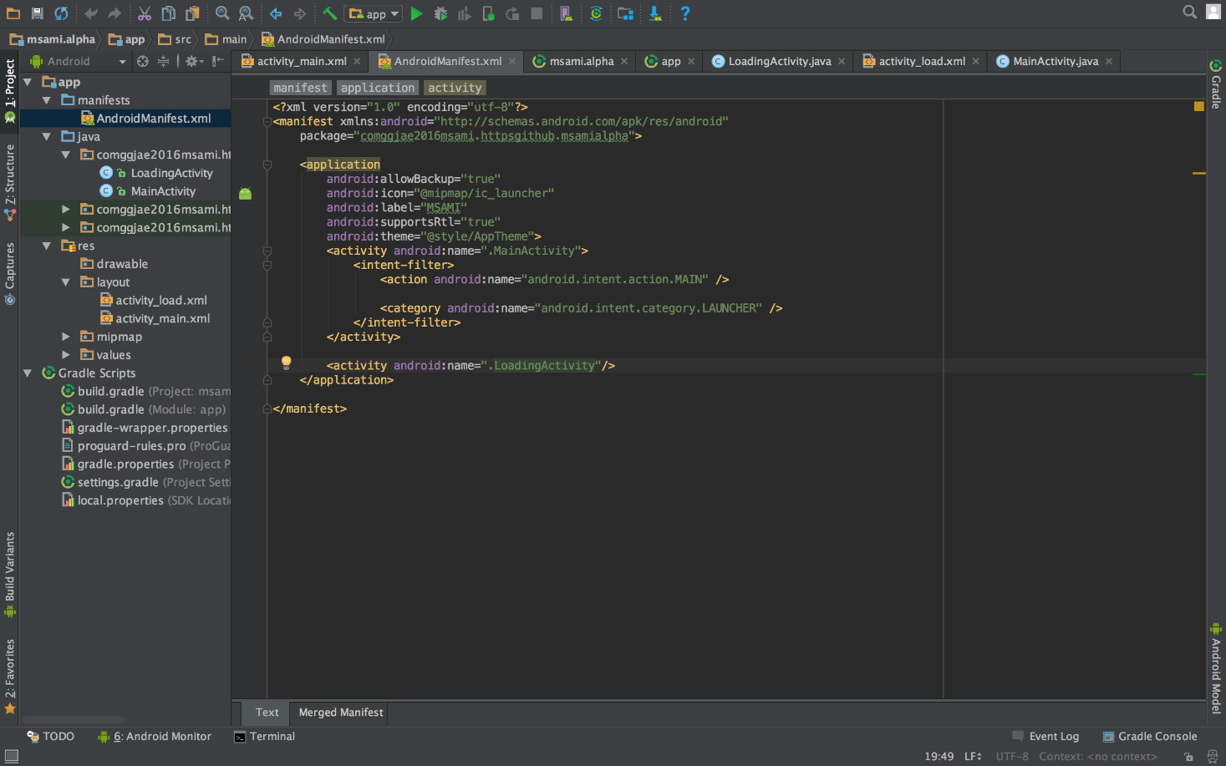
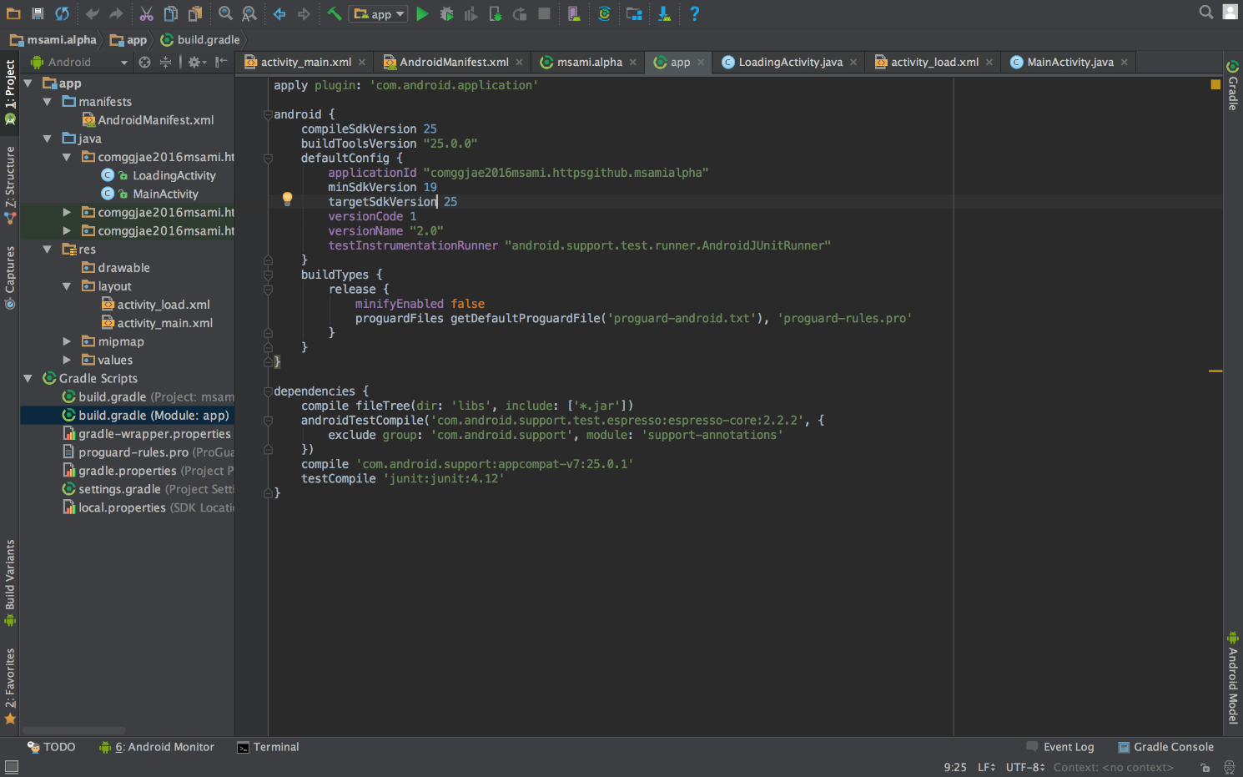
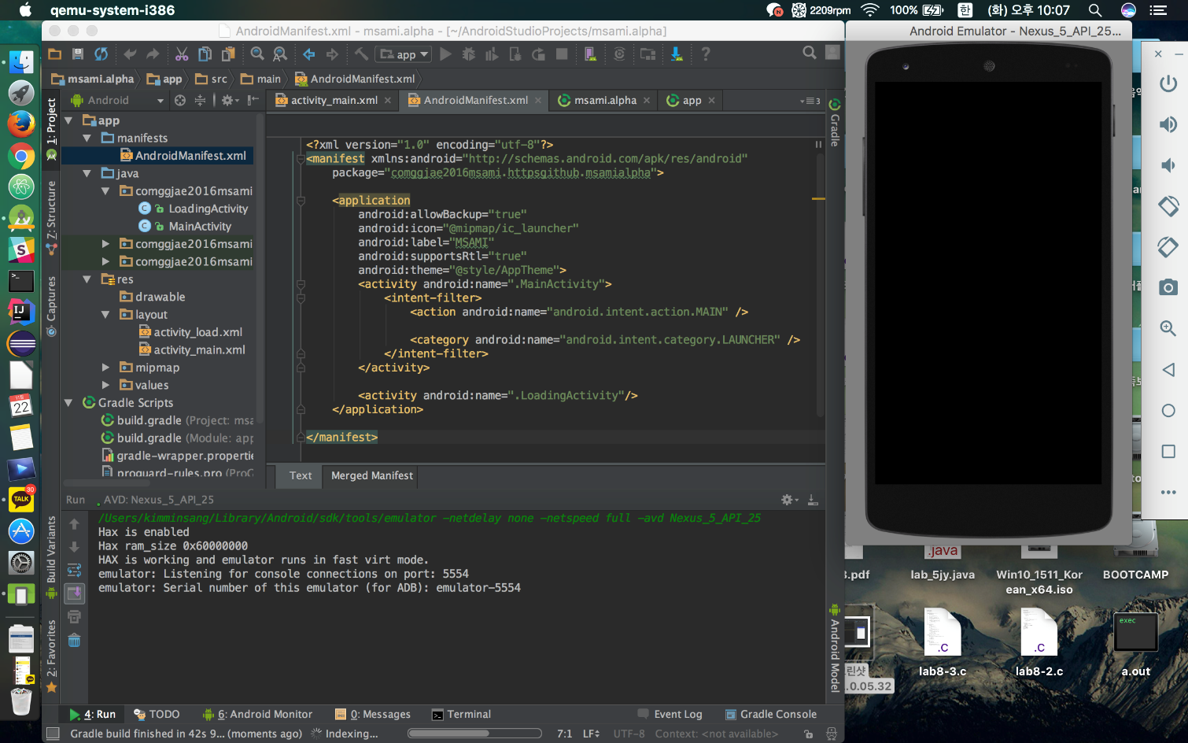
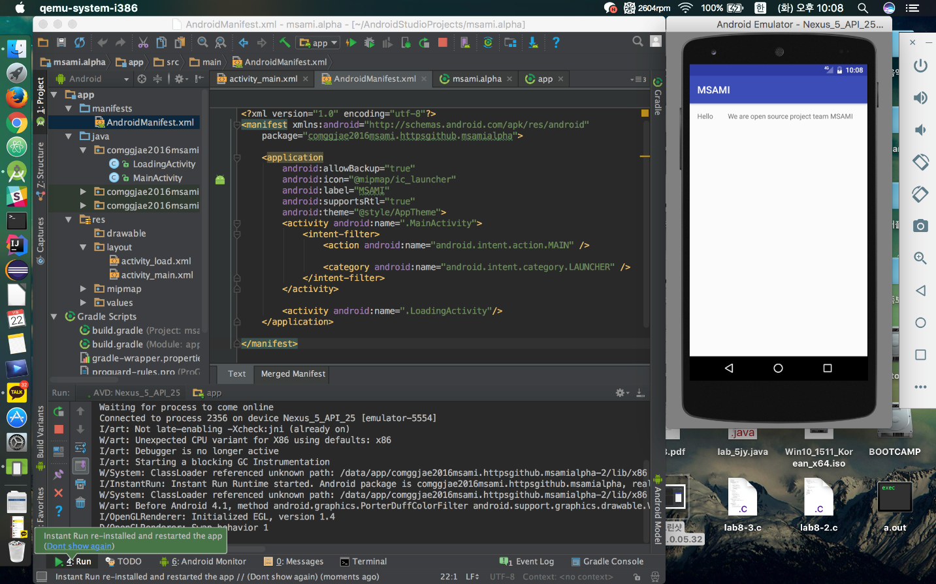
Develop Process

Slide 8
Problem
- Error Modify
- Build Error
- We solved it

Slide 9
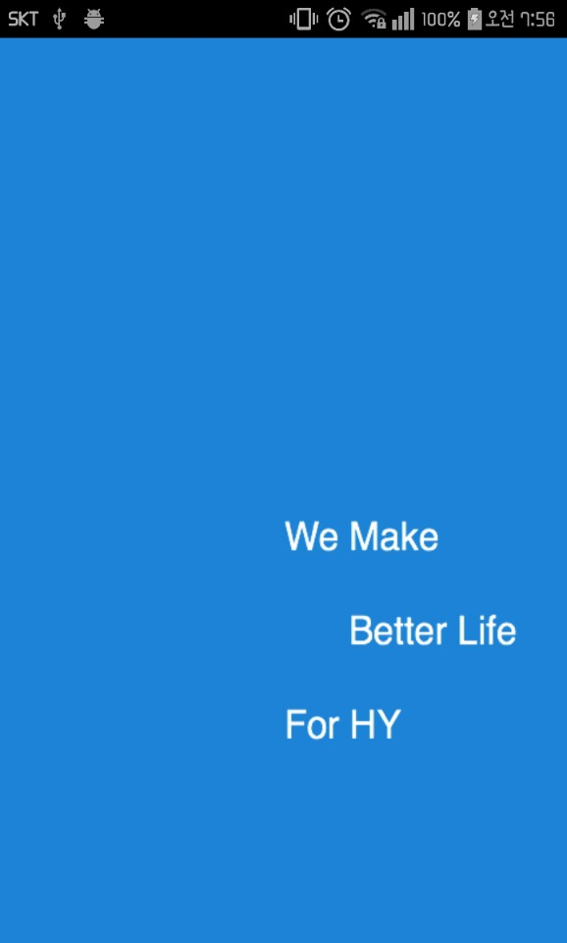
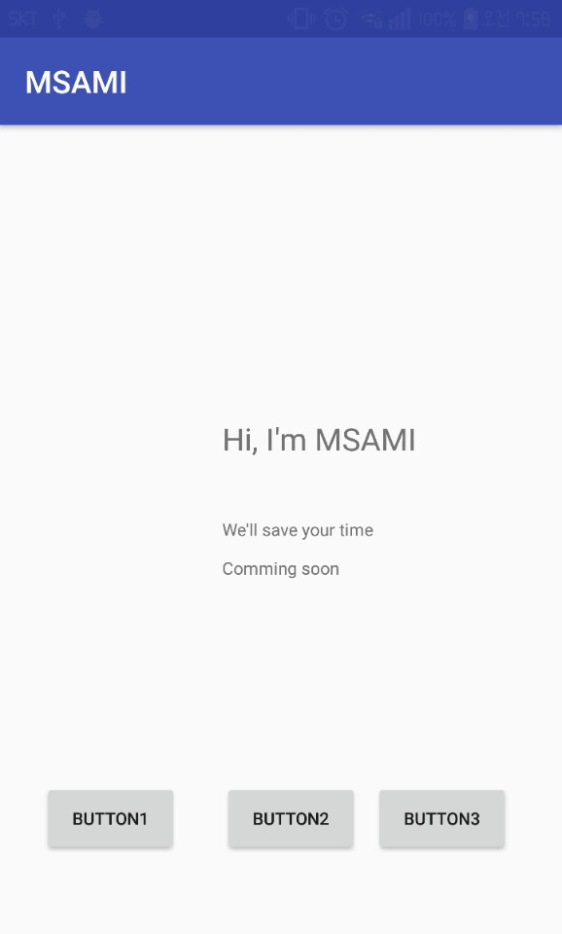
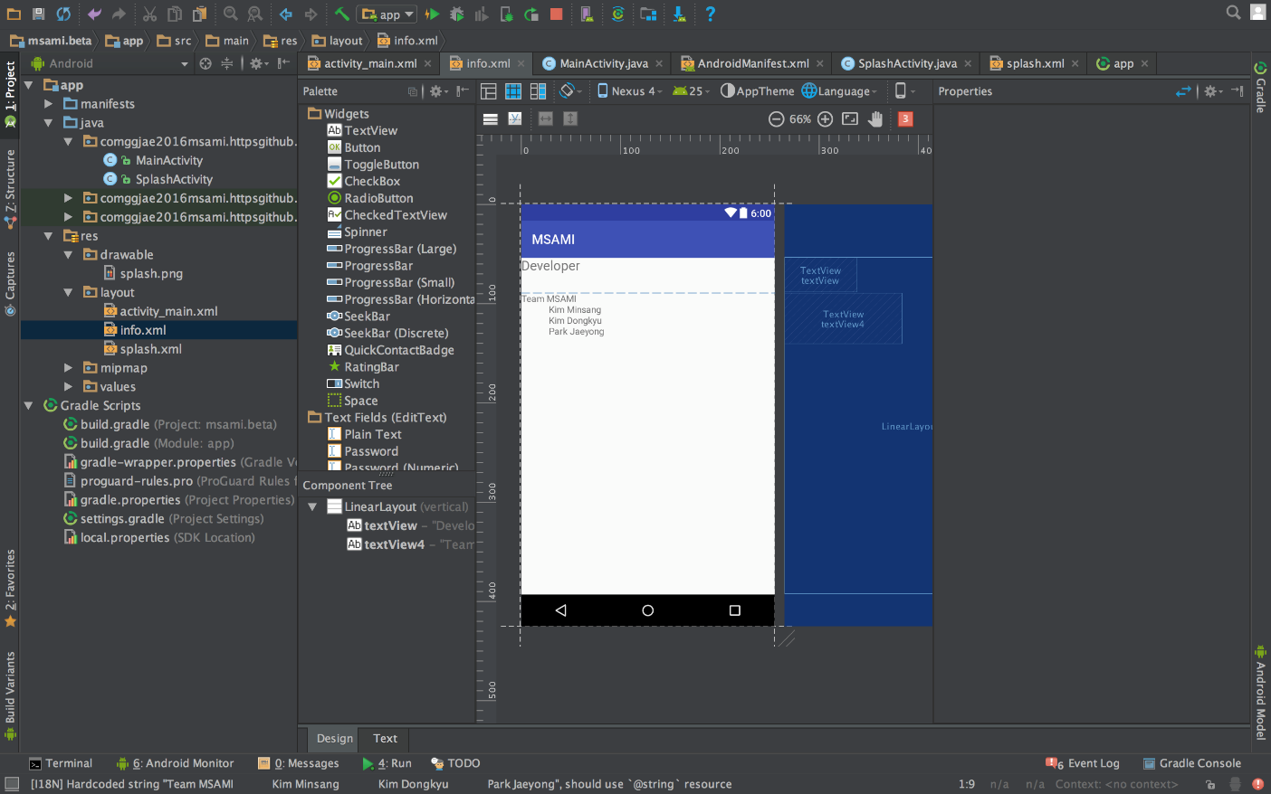
Mid-Result!

Slide 10
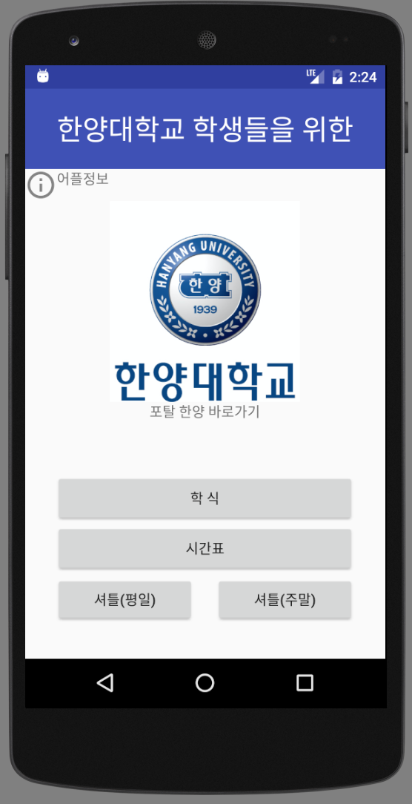
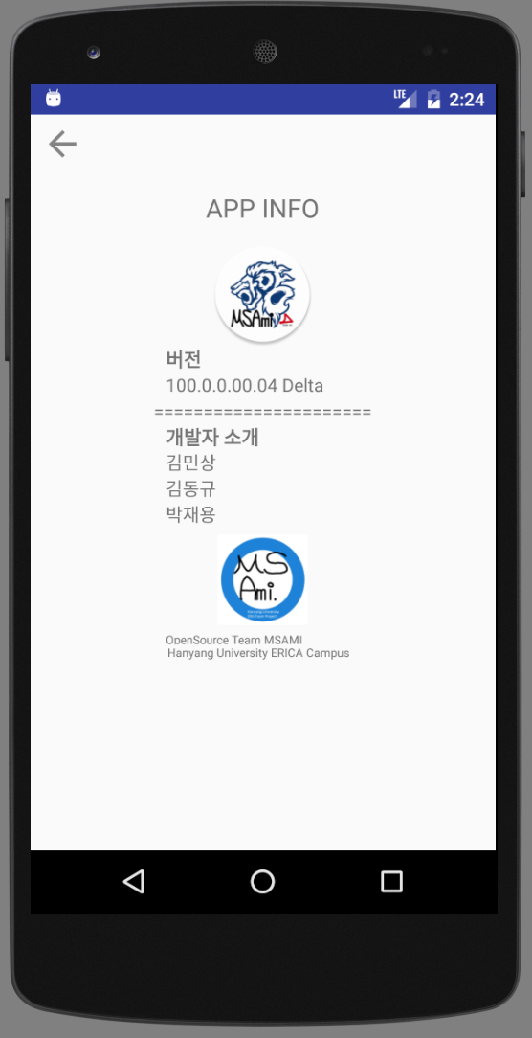
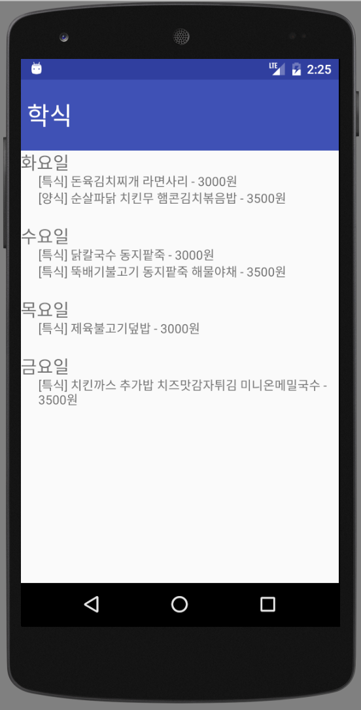
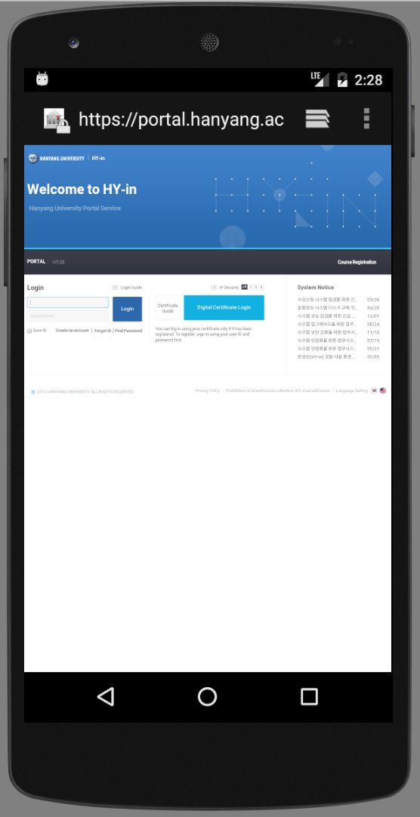
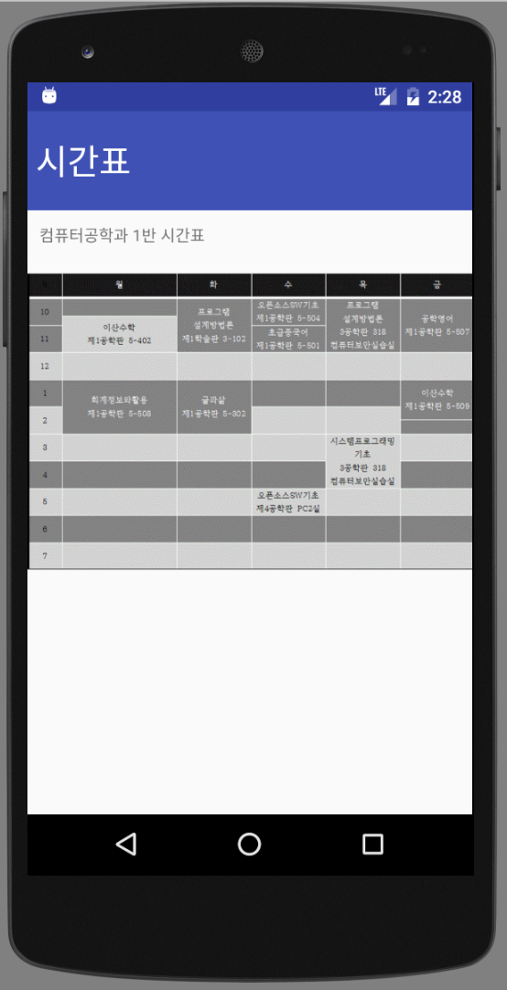
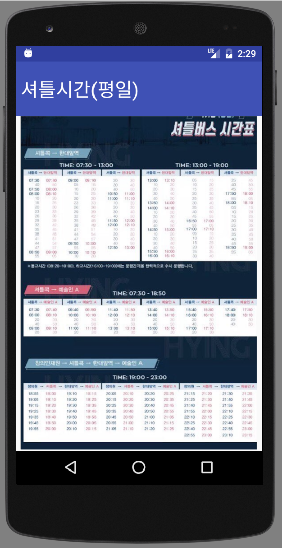
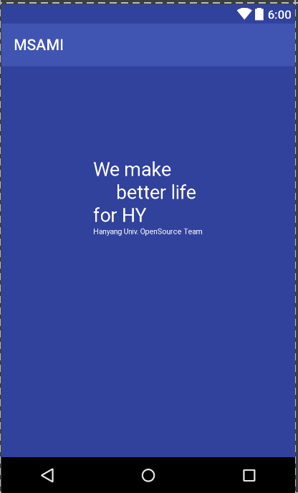
Final-Result!

Slide 11
Reference & License
Reference(lecture)
git\2016msami\reference.txt
License
- Apache 2.0

Slide 12
Goal & Future
1. Move Activity -> Activity
2. Add Function(Food, Timetable, Shuttle time, web quick button)
3. App info
Functions received from the server
Added photo zoom function

Slide 13
Demonstration

